Slide 1
Project Achievements
Online - 1 June 2026

Slide 2
Main Achievements
5G Optical Wireless Communication Network Architecture
  The 5G OWC network architecture integrates OWC with a Cell Free 5G Radio Access Network to marry the two technologies and benefit from their unique advantages to improve communication, coverage and localisation performance.
5G Optical Wireless Communications and Localisation Testbed Design and Key Performance Indicators
  The localisation test bed evaluates the performance of OWC communication for localisation using various localisation and positioning configurations and methods, namely: RSS, ToA, AoA.
Beamsteering-Based Optical Wireless ISAC Method
  As part of the OPTI-6G project, a new integrated sensing and communication (ISAC) method has been developed, tested and validated, exploiting the possibility of modifying the orientation of a single optical source using beamsteering techniques.

Slide 3
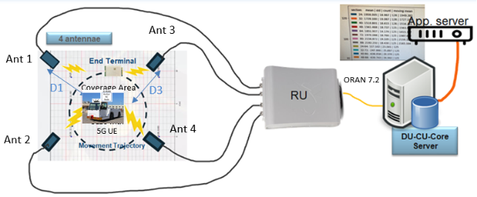
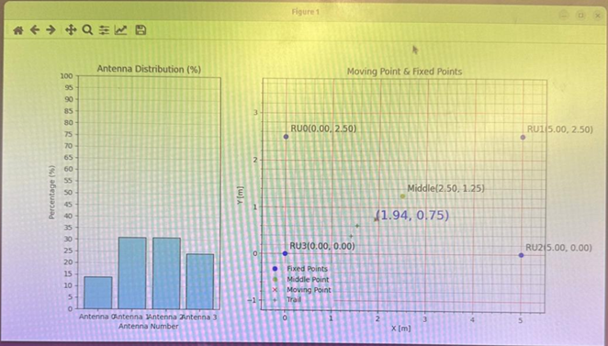
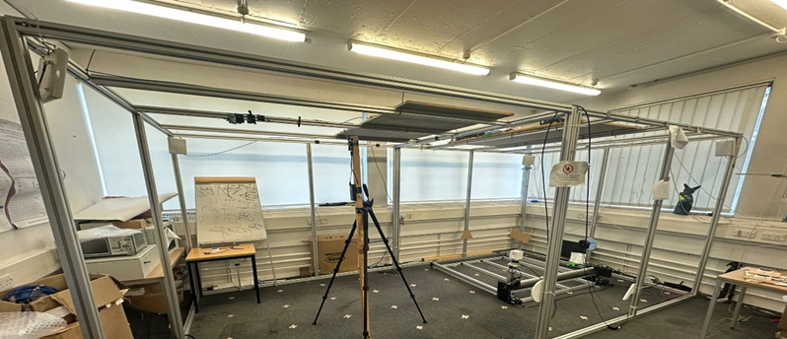
Localisation Sensing Based on Sub-6 GHz Time of Arrival Measurements
Localisation network
Related to Task: Task 4.1 OWC TDoA Localisation Sensing
Related to deliverable: D4.1OWC Localisation Sensing System Design
Brief introduction: The 5G UE in the AGVs transmits data to the 5G RU in the uplink channel, and the Data from the UE is detected in the RU via four different RU Antennas.
  RU measures the Time of Arrival (ToA) to the RU from four Antennas. The ToA measurements in the RU are transferred to the Application Server via the ORAN 7.2 Interface, the DU, the CU and 5G Core.
  The Application Server converts the ToA measurements to four distances between the Antennas and the AGV.
  Application Server calculates the real-time geographical location of the AGV using hyperbolic trilateration techniques.
Practical importance: This is the first step in the process of performing OWC ToA localisation. The second step is to replace the RF air interface with the OWC air interface.
Contributions and novelties:
  Contribution: Once the OWC air interfaces have been installed the location accuracy of an OWC version on the ToA system can be performed.
  Novelty: cm localisation accuracy for indoor and outdoor locations
Localisation dashboard
Test Area & Measurement points
3
Notes:
Israel is expected to present this

Slide 4
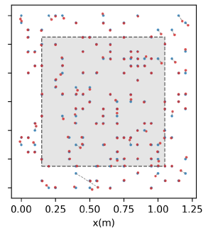
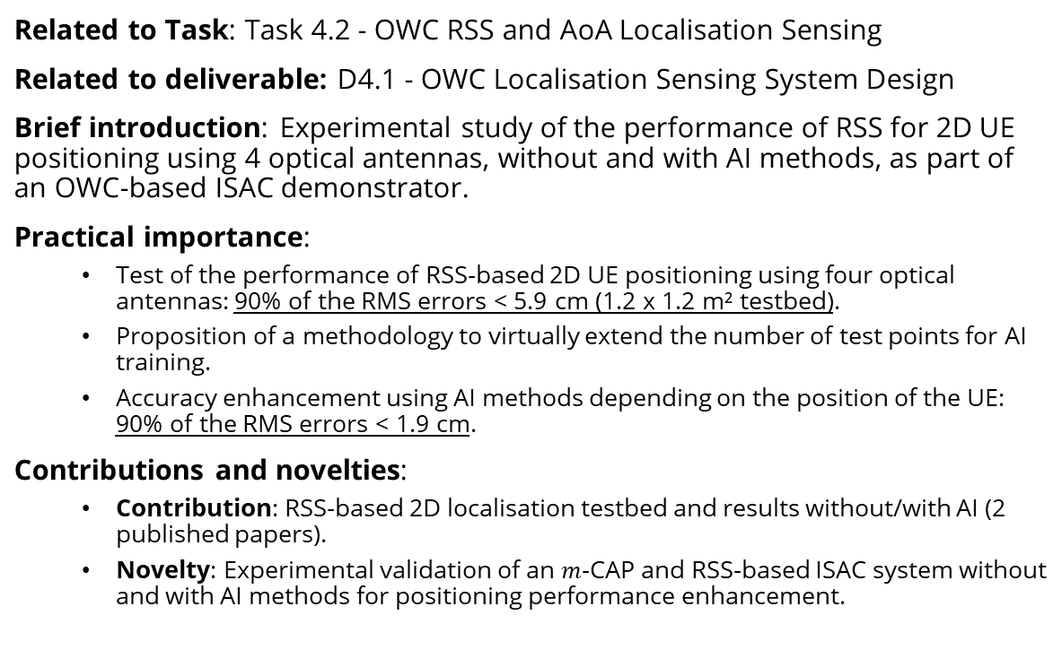
AI-Driven RSS-Based UE Localisation
Related to Task: Task 4.2 - OWC RSS and AoA Localisation Sensing
Related to deliverable: D4.1 - OWC Localisation Sensing System Design
Brief introduction: Experimental study of the performance of RSS for 2D UE positioning using 4 optical antennas, without and with AI methods, as part of an OWC-based ISAC demonstrator.
Practical importance:
  Test of the performance of RSS-based 2D UE positioning using four optical antennas: 90% of the RMS errors < 5.9 cm (1.2 x 1.2 m² testbed).
  Proposition of a methodology to virtually extend the number of test points for AI training.
  Accuracy enhancement using AI methods depending on the position of the UE: 90% of the RMS errors < 1.9 cm.
Contributions and novelties:
  Contribution: RSS-based 2D localisation testbed and results without/with AI (2 published papers).
  Novelty: Experimental validation of an $m$-CAP and RSS-based ISAC system without and with AI methods for positioning performance enhancement.

Slide 5
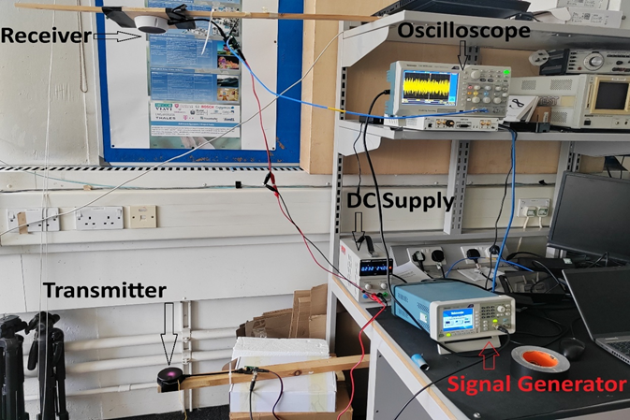
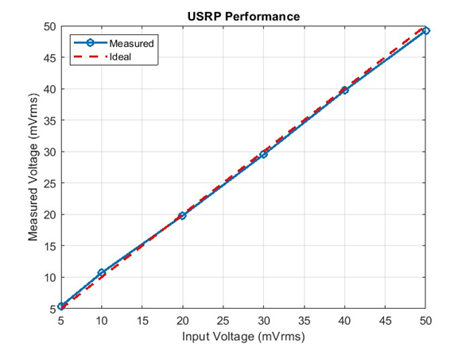
UE Localisation Sensing Based RSS Measurements
Related to Task: Task 4.2 OWC RSS and AoA Localisation Sensing
Related to deliverable: D4.1 OWC Localization Sensing System Design
Brief introduction: Initial experiments were conducted to measure RSS at varying distances from the transmitter to provide insight into the signal attenuation characteristics of the system. The results serve as an early validation of the system design and offer guidance for refining antenna placement and processing strategies in subsequent experiments.
A Ettus Research USRP X310 equipped with two TwinRX daughter boards is employed as a platform capable of processing measurements from multiple optical antennas simultaneously in real time.
Practical importance:
  Linearity: The USRP is fed with increasing RMS voltages (5–50 mVrms). This shows good linearity of the ADC/amplifier path. Small deviations (<3%) are expected due to front-end tolerances, calibration offsets, and quantisation.
  Accuracy: The relative error between input and measured RMS is small e.g. Accuracy improves at higher amplitudes because quantisation noise and offset errors are less significant compared to signal power.
Contributions and novelties:
  Contribution: Once the RSS principles of operation have been confirmed to successfully operate with Optical Wireless LAN Air Interface, the same RSS principles of operation can be applied to Optical Wireless 5G Air Interface
  Novelty: Experimental setup report and result data have been shared on Zenodo for other research groups to validate results.

Slide 6
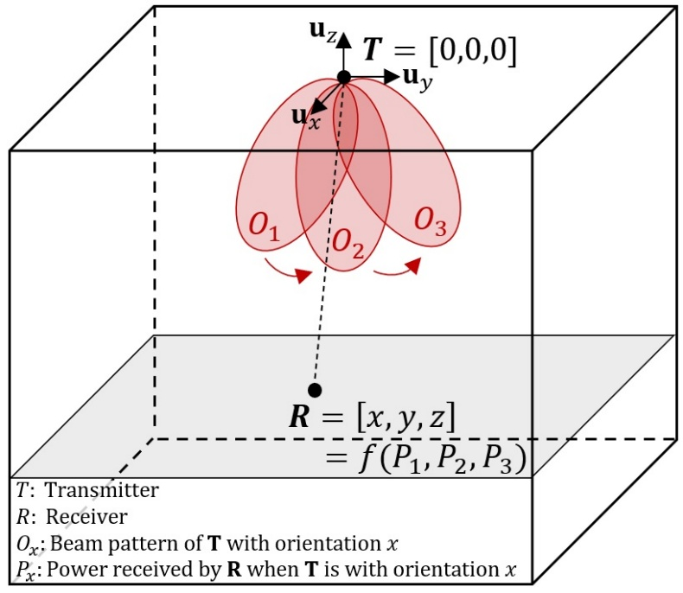
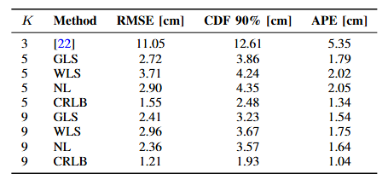
Beamsteering-Based UE Localisation: Theory
Related to Task: Task 4.2 - OWC RSS and AoA Localisation Sensing
Related to deliverable: D4.1 - OWC Localization Sensing System Design
Brief introduction: New beamsteering-based 3D positioning method using a single steerable optical source and a single photoreceiver at the UE side.
Practical importance:
  New 3D positioning method requiring only a single optical source and a single photoreceiver, whereas conventional methods require at least 3 sources / and or receivers.
  Theoretical 3D positioning accuracy in the 2-3 cm range, despite noise and reflections of the environment, without AI-driven methods.
Contributions and novelties:
  Contribution: Beamsteering-based 3D positioning method
  (1 published paper, 3 submitted papers).
  Novelty: Beamsteering-based 3D positioning method using a single optical source and a single receiver.

Slide 7
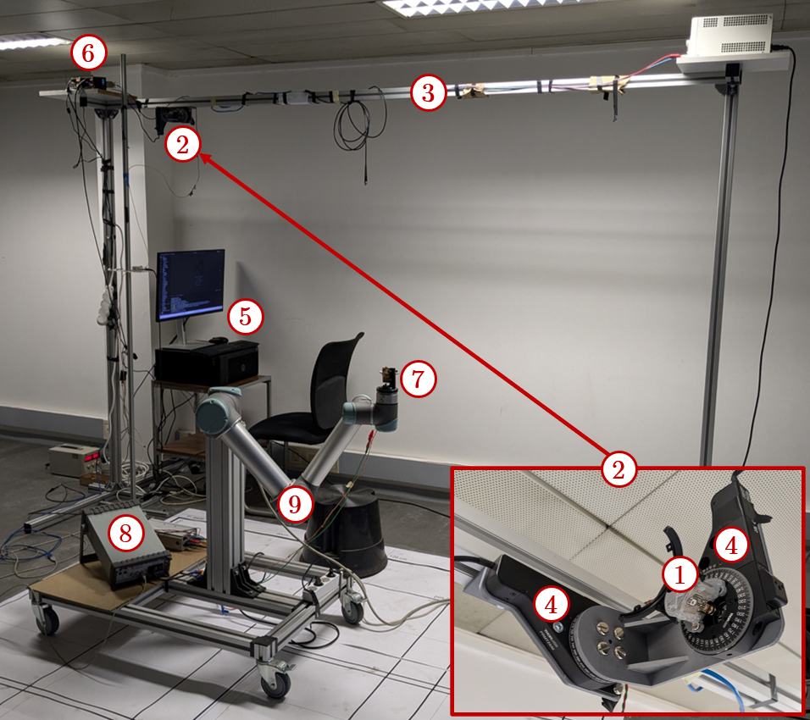
Beamsteering-Based UE Localisation: Test-Bed
Related to Task: Task 4.2 - OWC RSS and AoA Localisation Sensing
Related to deliverable: D4.1 - OWC Localization Sensing System Design
Brief introduction: Testbed enabling validation of the beamsteering-based localisation method.
Practical importance:
  Integrates a steerable platform on the infrastructure side, on which different optical antennas can be mounted.
  Uses a robot arm to test different positions and movements of the UE.
Contributions and novelties:
  Contribution: A “beamsteering-based localisation testbed”.
  Novelty: Steerable optical antennas on the infrastructure and user side using custom-made mechanical beamsteering (infrastructure) and a robot arm (user).

Slide 8
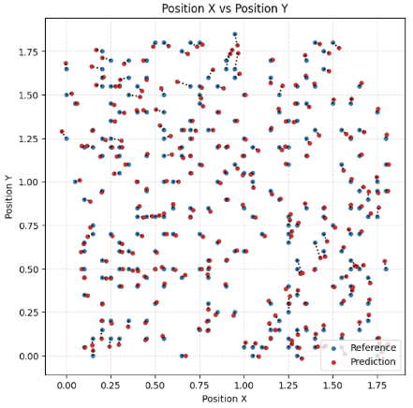
Beamsteering-Based UE Localisation: Tests
Related to Task: Task 2.3 - Testing and KPI Verification Methodology
Related to deliverable: D2.3 - OWC Cell Free Network Testing and KPI Verification Methodology
Brief introduction: Experimental validation of the new beamsteering-based UE localisation method in 2D.
Practical importance:
  Beamsteering-based localisation concept validated experimentally in 2D.
  Test of multiple AI-driven methods to enhance localisation accuracy.
  90% of the errors < 2.8 cm over a 1.8 x 1.8 m² test area.
Contributions and novelties:
  Contribution: 2D validation of the proposed beamsteering-based localisation method in 2D (1 paper in progress).
  Novelty: Proof-of-concept in 2D of the new beamsteering-based localisation method.
Demonstration video here
Demonstration video here

Slide 9
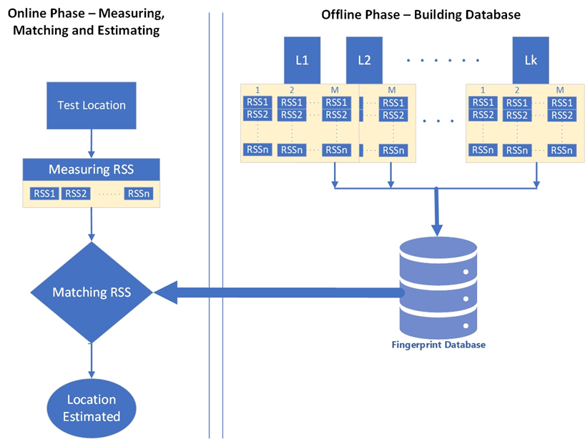
ToA and RSS Localisation Methods Fusion Using Fingerprinting
Related to Task: Task 4.3 Integration and Testing of Optical Location Systems
Related to deliverable: D4.1OWC Localisation Sensing System Design
Brief introduction: One of the prominent methods for localisation in OWC systems is RSS-based fingerprinting, which uses the RSS at various points in an environment to create a “fingerprint” of the location. RSS-based localization involves non-linear relationships between the RSS values from multiple LEDs and the physical location of the receiver.
Practical importance: ANN models are well-suited to model these non-linear relationships because they can “learn” from data to map RSS measurements to positions. The key benefits of using ANN for localization include: Learning from data complex relationships between RSS values and physical positions by training on a dataset of RSS measurements. Handling non-linearity can improve accuracy in environments were multipath fading or shadowing affect RSS measurements. Robustness handles noisy or variable RSS data, providing more reliable localization compared to traditional methods.
Contributions and novelties:
  Contribution:
  High Accuracy: ANN models can significantly improve the localization accuracy by learning
  the complex relationships between RSS and location, especially in environments with non-line-of-sight conditions and even deduce the orientation of UE.
  Robustness to Noise: ANN models are robust to noise in the RSS data, allowing for more reliable position estimates in the presence of environmental interference
  Novelty: ANNs can be retrained with new data when the environment changes, allowing them to adapt to dynamic environments with minimal manual intervention thus making suitable for data fusion.

